Slide 1


Professional Dress Guidelines
Men

Slide 2

Professional appearance is an important aspect of the overall preparation of BPA members for the business world. So students represent Oklahoma BPA and the National BPA Association in a professional and business-like manner with the highest of professional standards this dress code has been established.
It is the responsibility of the chapter advisors to ensure students adhere and comply with the established dress code. Students, advisors, and chaperones must follow the dress code.

Slide 3
Oklahoma BPA does not require the official BPA blazer for competition, and students not wearing the official BPA blazer will not be penalized during any competition. However, strict adherence to these guidelines is mandatory for conference attendees while attending conference functions. These functions include, but are not limited to: competitions, official BPA meetings, and award ceremonies.

Slide 4
There are two divisions of dress code: Professional Dress and Business Casual. Professional dress is required while competing, while on stage, or attending any official Oklahoma BPA meeting or event. Business Casual is designed for any time other than when professional dress is required. While on conference property students are required to adhere to this dress code at all times. When students are not competing, presenting, or attending an official Oklahoma BPA function they must still dress in a manner that is appropriate representation of Oklahoma BPA. Students not adhering to or in question of this official dress code policy will not be allowed on stage to receive an award. All decisions are final by state staff regarding dress code. Judges will assess each contestant’s dress during competition. The student will have a point deduction for not following the appropriate dress code.

Slide 5
Local advisors, please review this dress code with your students prior to attending the conference. Oklahoma BPA wants every student to have the opportunity to succeed and be recognized on stage, but students will be denied the privilege to attend events and appear on stage if they are dressed inappropriately.
Important!

Slide 6
Professional Dress
Guidelines
Competition
On Stage
Official Oklahoma BPA Events

Slide 7
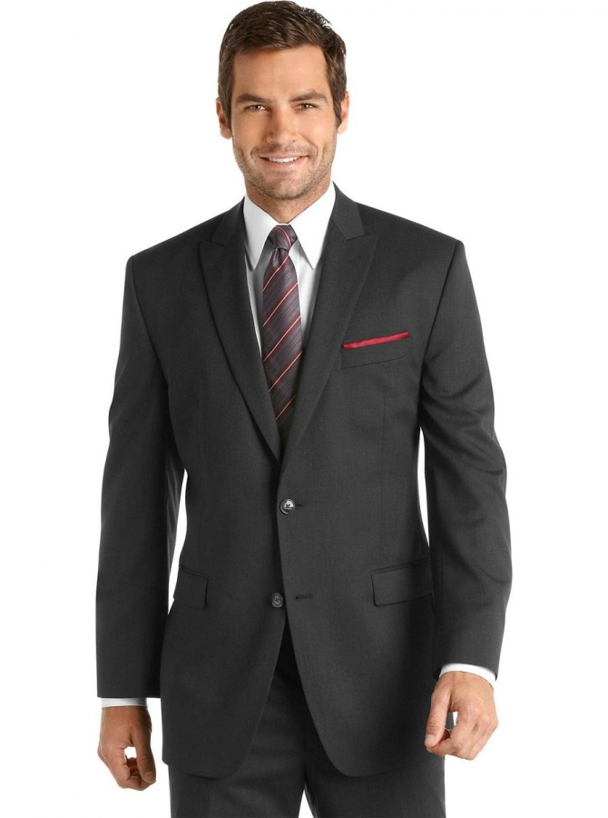
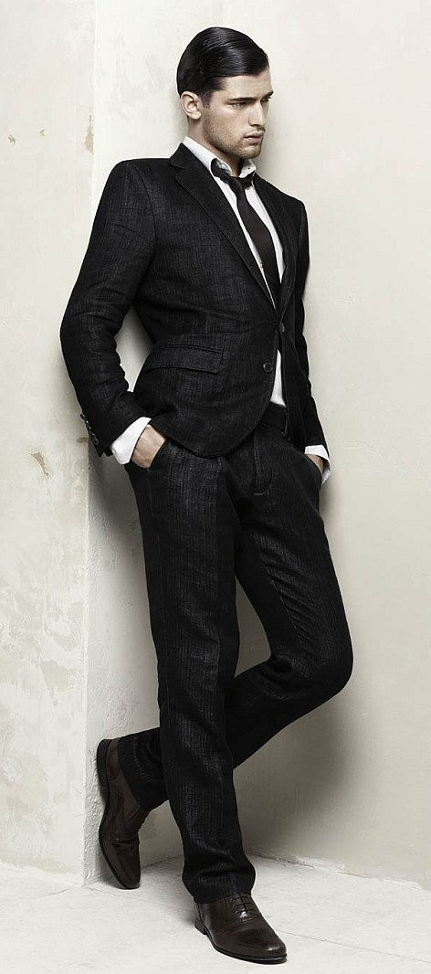
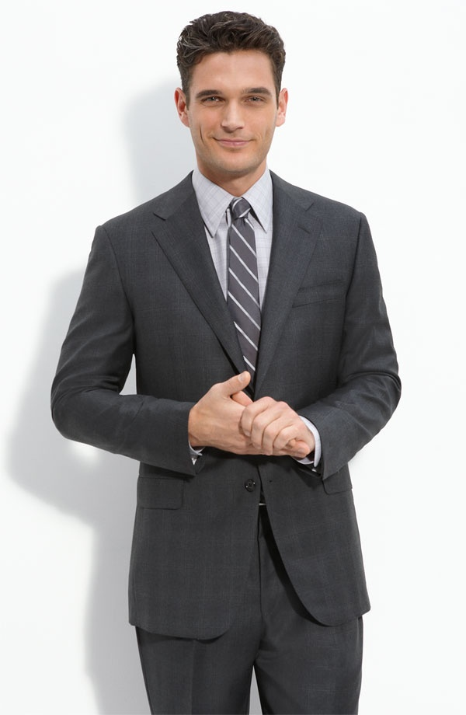
Suit
Acceptable

Slide 8
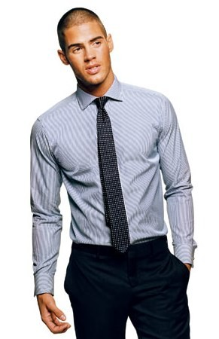
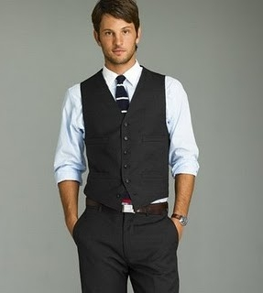
Slacks and Shirt
Acceptable

Slide 9
Shirts must be tucked in!

Slide 10
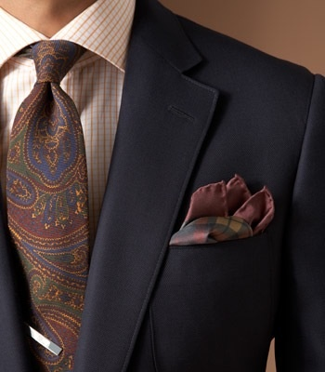
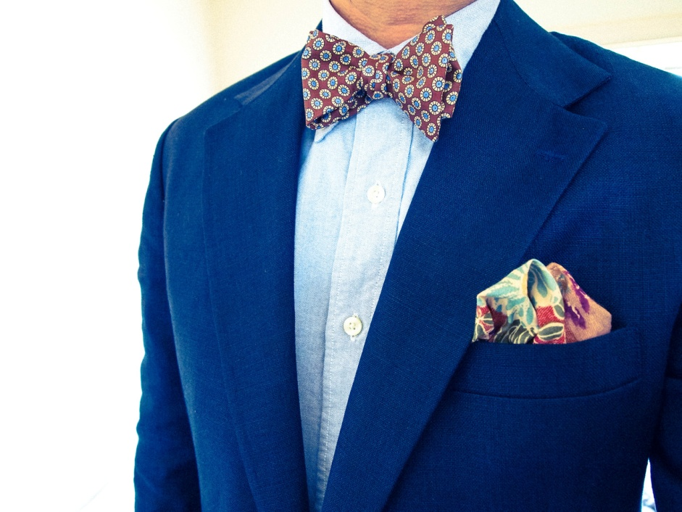
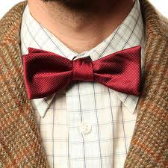
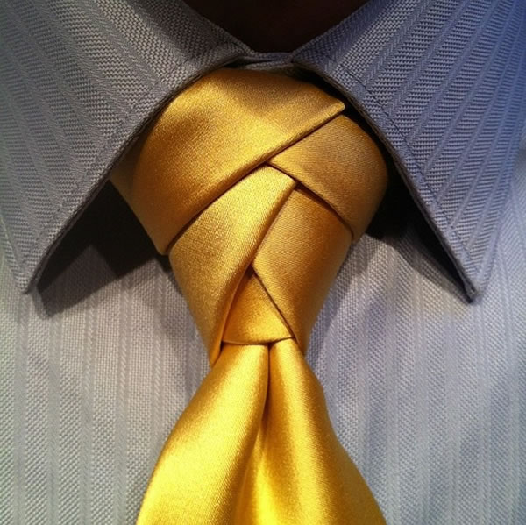
Necktie
Acceptable

Slide 11
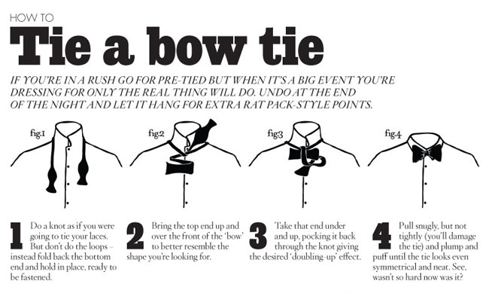

Slide 12
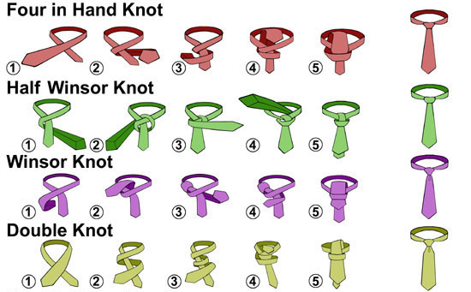
How to tie a tie

Slide 13
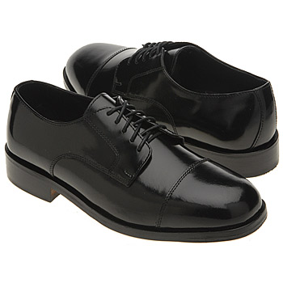
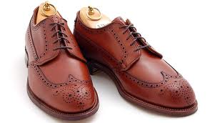
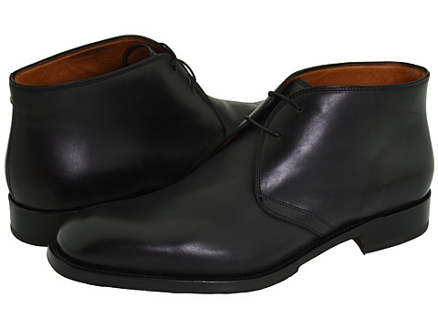
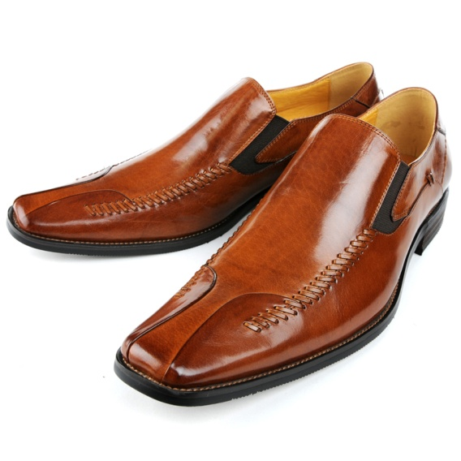
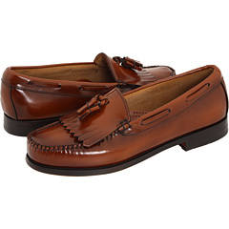
Shoes
Acceptable

Slide 14
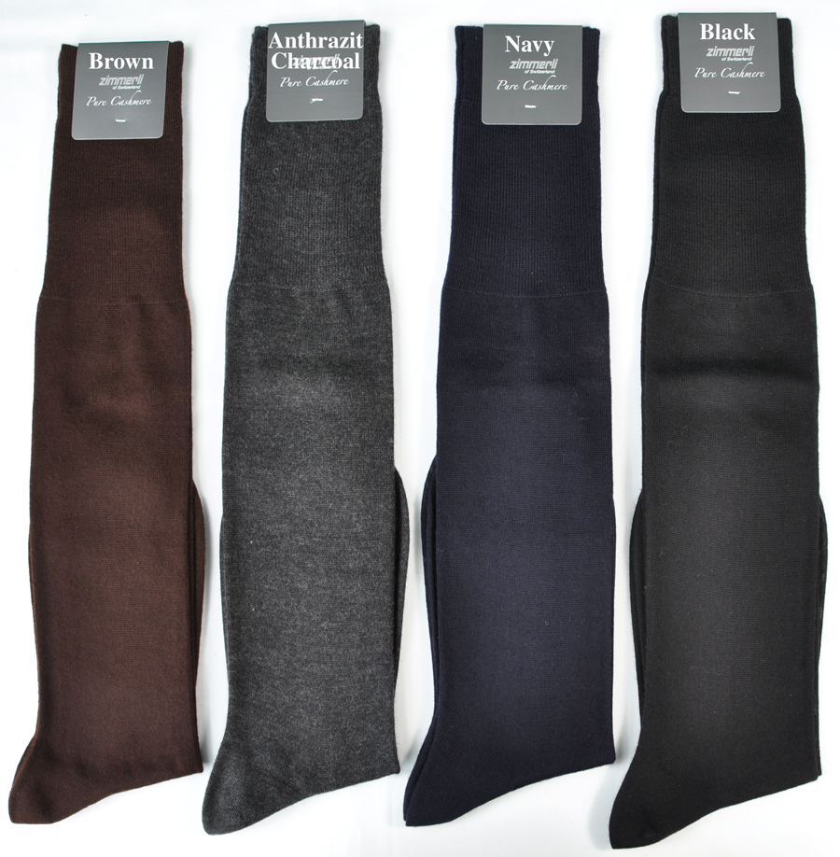
Socks
Acceptable

Slide 15
A good rule of thumb when it comes to socks and shoes-
Nothing over-the-top, keep it simple, neutral, and matching.

Slide 16
Unacceptable
Attire

Slide 17
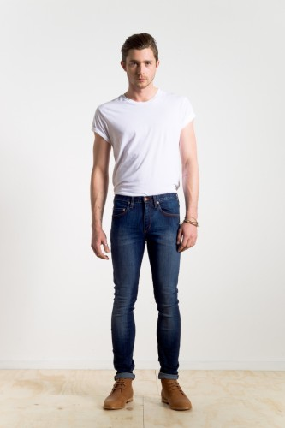
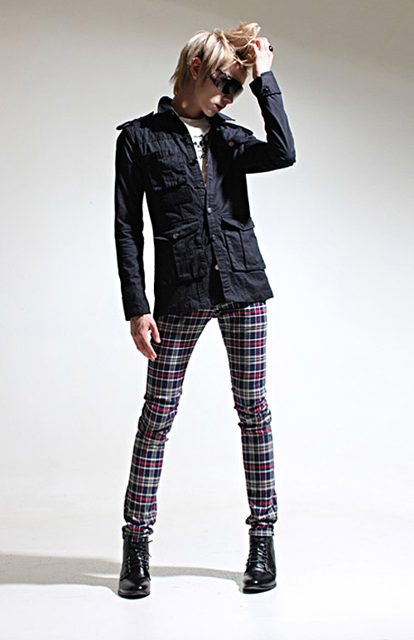
Unacceptable
Skin tight or revealing clothing will not be tolerated.

Slide 18
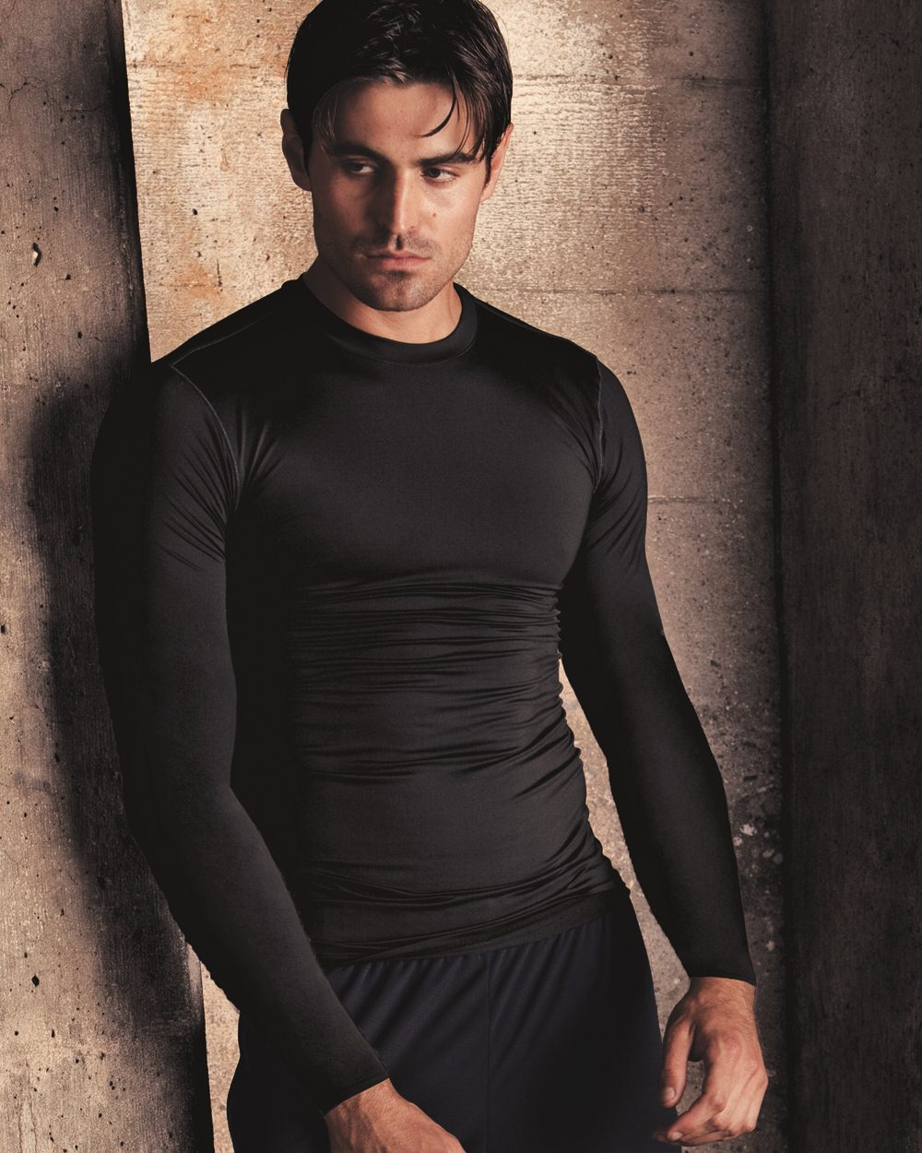
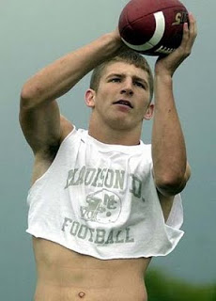
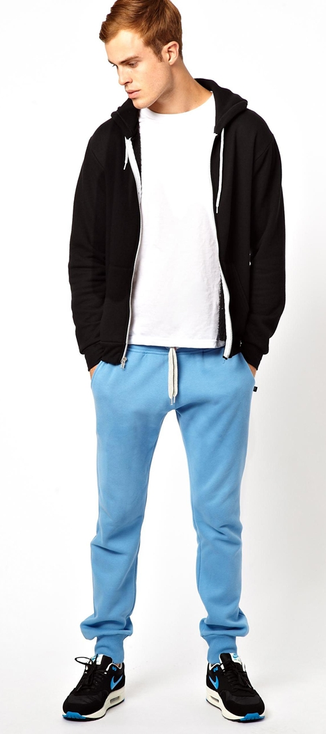
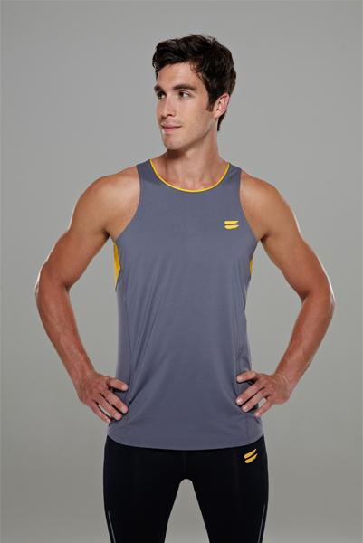
Unacceptable
Athletic clothing is not allowed!

Slide 19
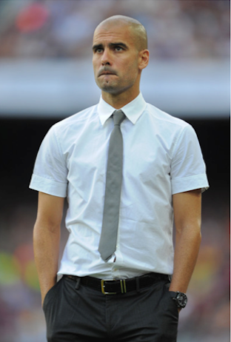
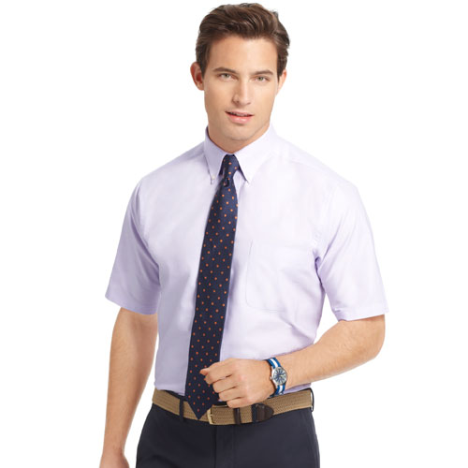
Unacceptable
Short sleeve dress shirts are not acceptable!

Slide 20
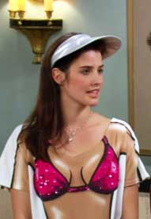
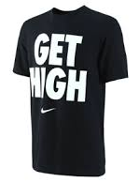
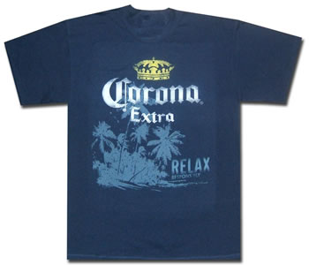
Unacceptable
Clothing that is suggestive, obscene, or promotes illegal substances will not be tolerated.

Slide 21
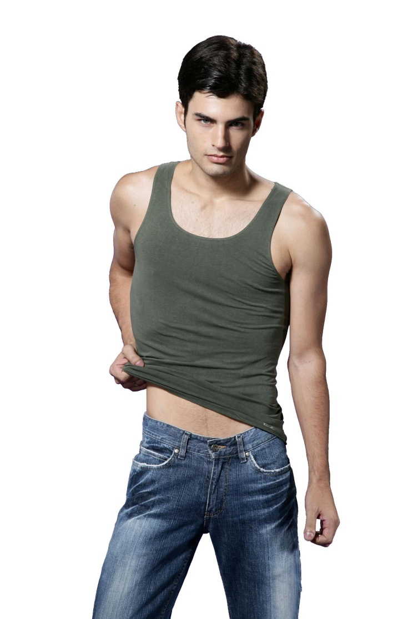
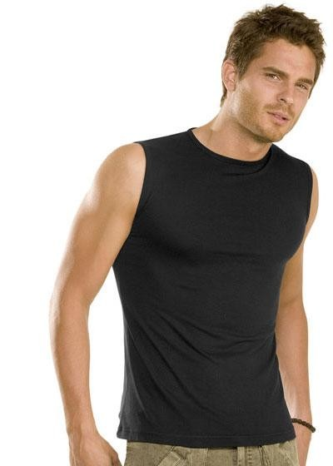
Unacceptable
Sleeveless or see-through clothing is not allowed!

Slide 22
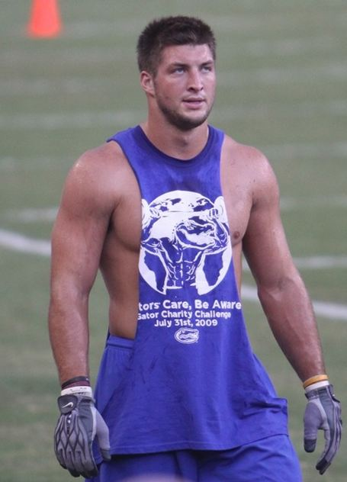
Unacceptable
Shirts with cut outs
will not be tolerated.

Slide 23
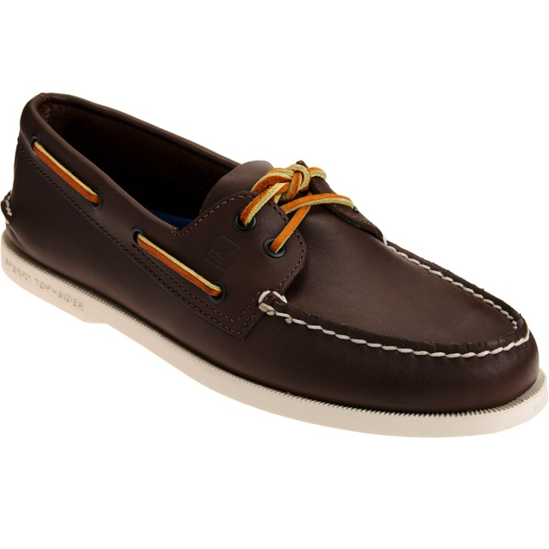
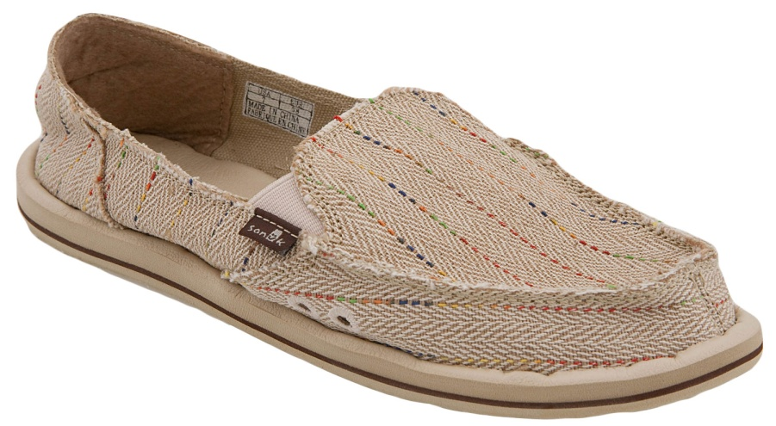
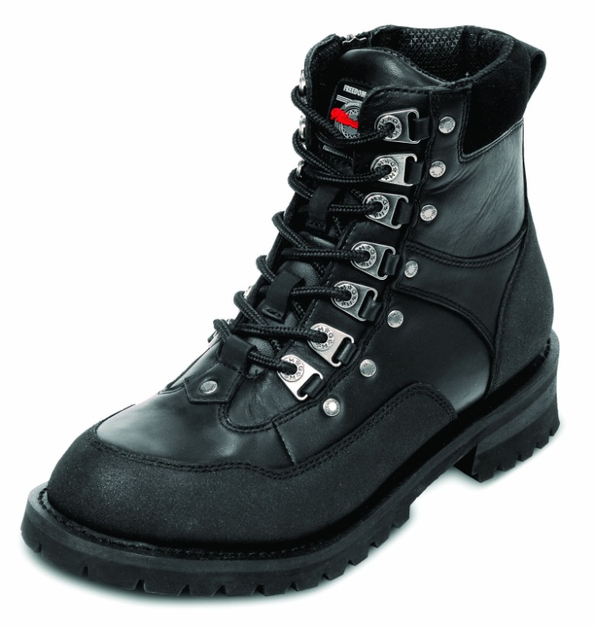
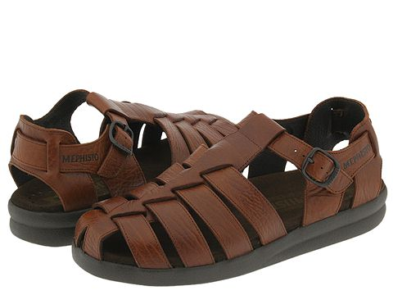
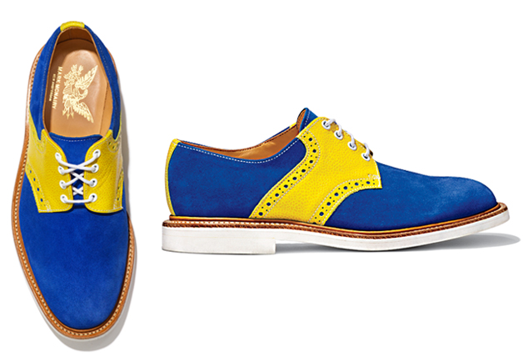
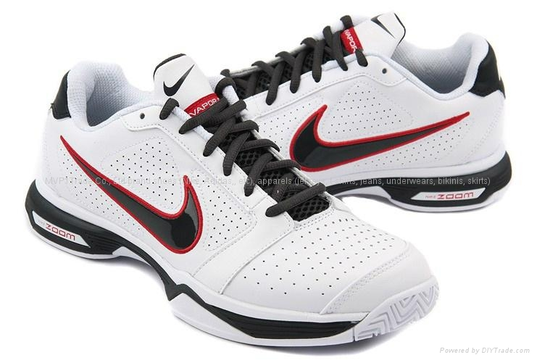
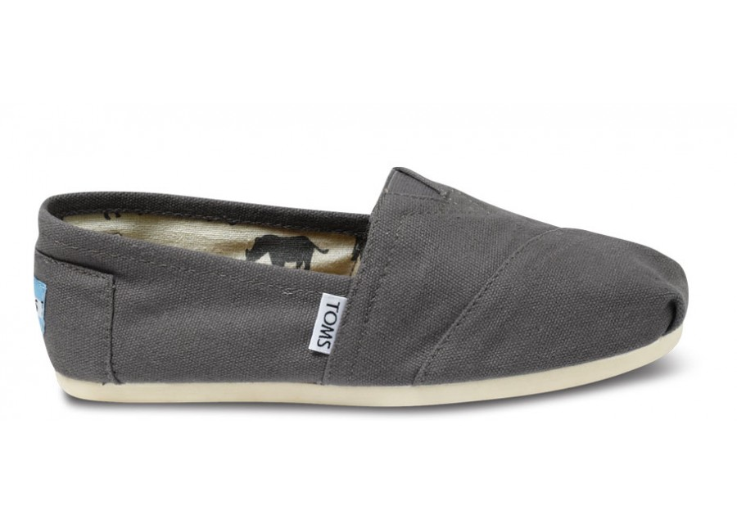
Unacceptable Shoes:
Flip Flops
Open Toe
Open Heel
Boat Shoes
Canvas Shoes
Tennis Shoes
Casual Shoes
Studded Shoes
Bright Shoes
Unacceptable

Slide 24
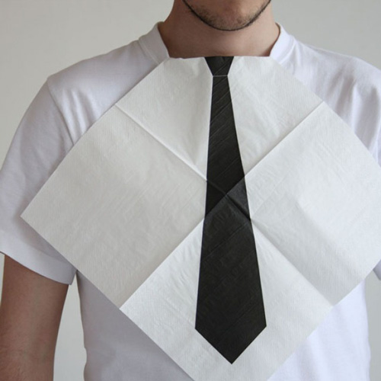
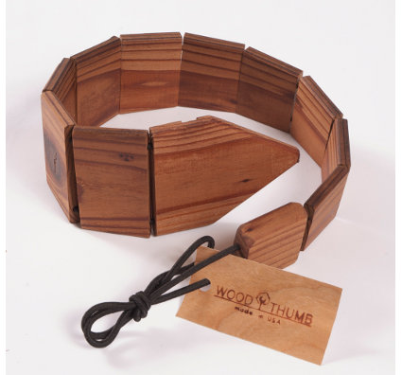
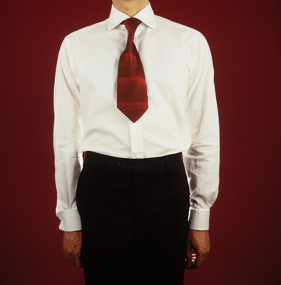
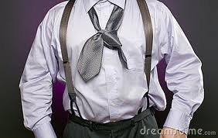
Unacceptable
Neckwear must be fabric, tied correctly, and made for adults!

Slide 25
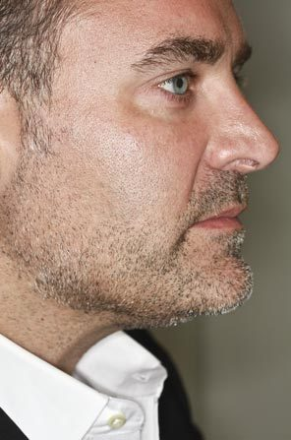
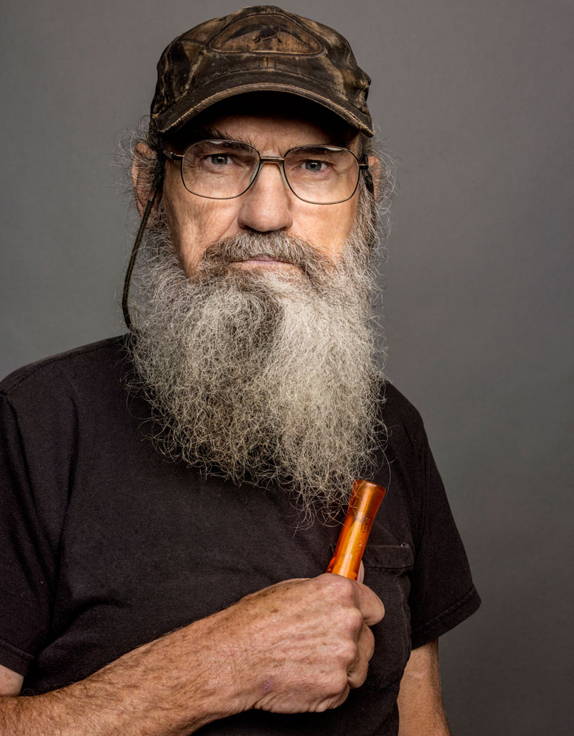
Unacceptable
Facial hair must be trimmed and neat!

Slide 26
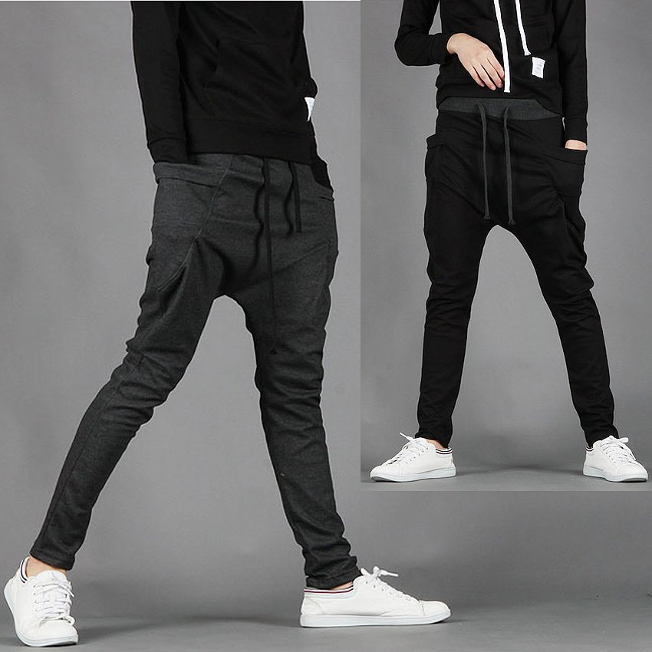
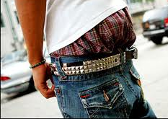
Unacceptable
Baggy pants are not allowed.
Pants must be worn at the waist.

Slide 27
Wear a belt!

Slide 28
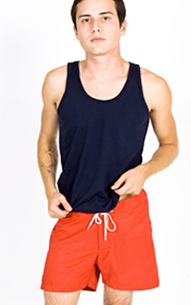
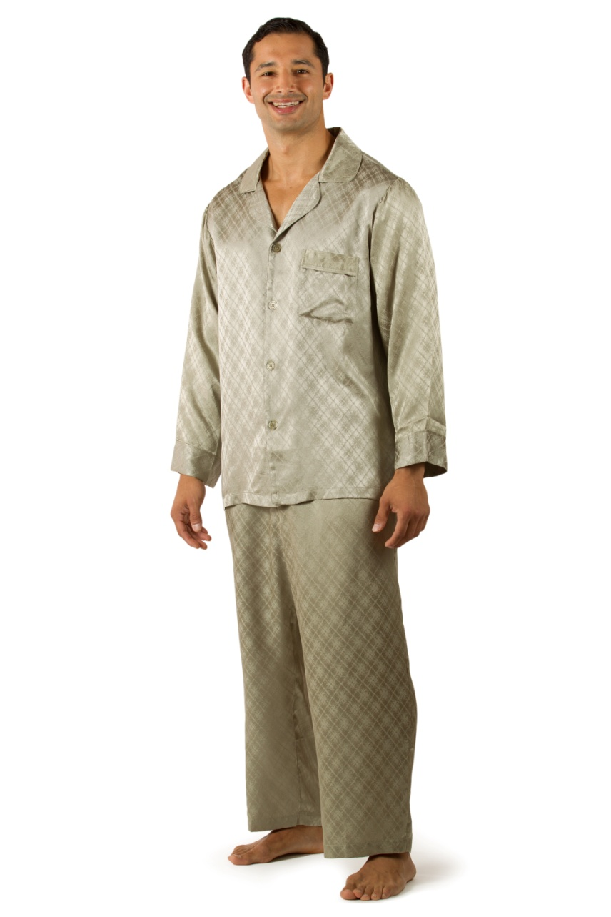
Unacceptable
Swimwear and sleepwear are not allowed.

Slide 29
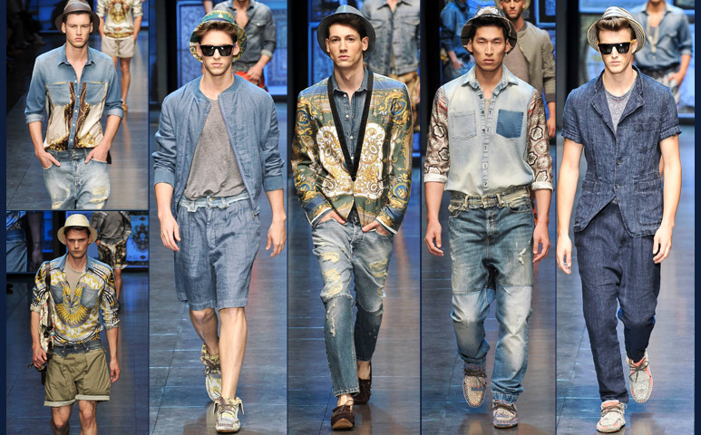
Unacceptable
Denim is not allowed at competition, on stage, or at any official BPA event.

Slide 30
Everyone wants to look stylish, but sometimes looking stylish is not the same as looking professional.

Slide 31
Be conservative and use discretion.

